Slide 1

BRITISH AIRWAYS
Web Scraping to Gain Company Insights

Slide 2
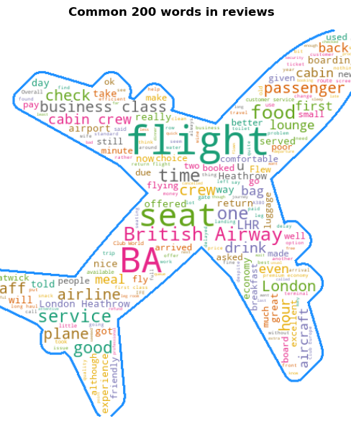
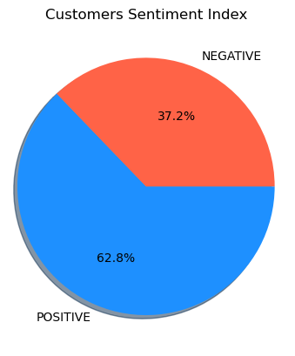
INSIGHTS FROM CUSTOMER REVIEWS
From 200 reviews given by the customers,
Positive Reviews : 126
Negative Reviews : 74

